Slide 1

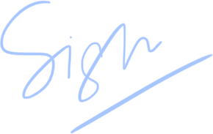
Certificate of Excellence
presented to
https://api.qrserver.com/v1/create-qr-code/?color=000000&bgcolor=FFFFFF&data=David%20Wilson&qzone=1&margin=0&size=400x400&ecc=L
for
<image>
Best attendance
https://api.qrserver.com/v1/create-qr-code/?color=000000&bgcolor=FFFFFF&data=David%20Wilson&qzone=1&margin=0&size=400x400&ecc=L
Teacher
Date

